Slide 1



Information flow and behavioural plasticity guide the phases of foraging in Aphaenogaster senilis
¹Pol Fernández-López & ^{1,2,3}Frederic Bartumeus
¹Centre d’estudis avançats de Blanes (CEAB)
²Centre de Recerca Ecològica i Aplicacions Forestals (CREAF)
³Institucio Catalana de Recerca i Estudis Avançats (ICREA)

Slide 2
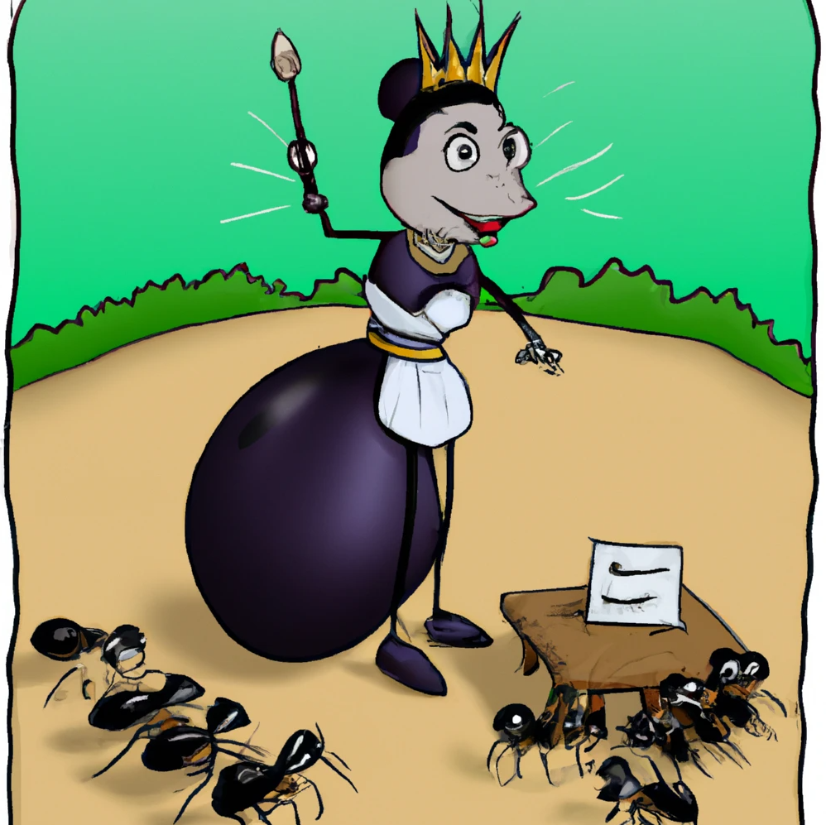
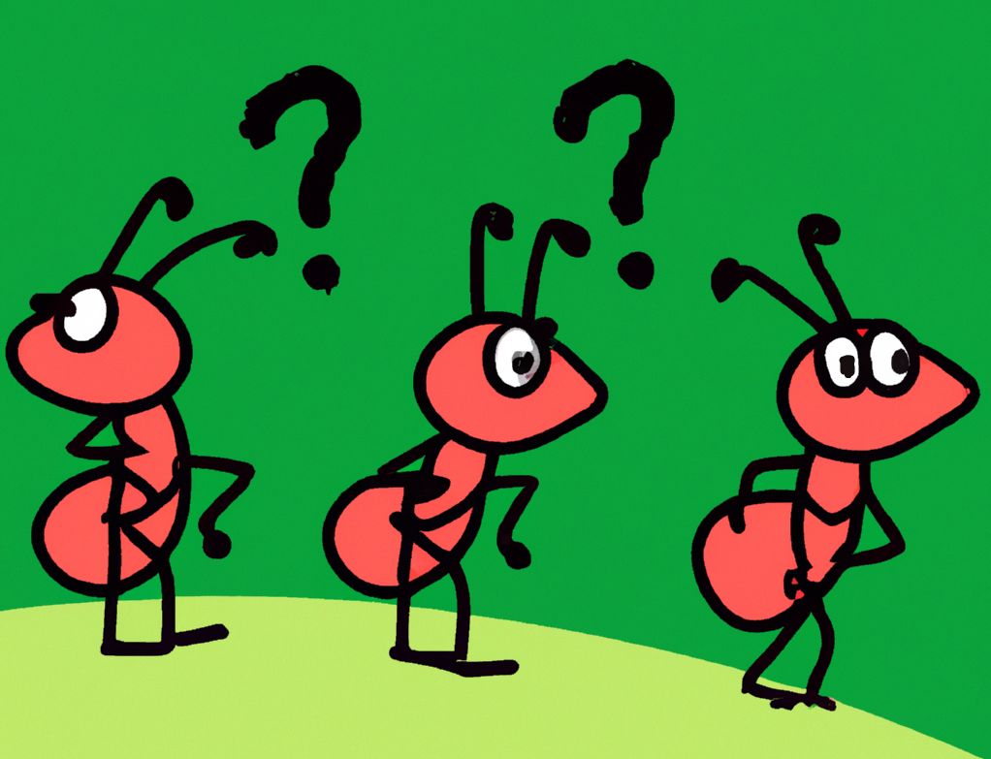
Ants as a society
Ants are social organisms, and as such, they must organize and coordinate in order to respond to the colonies needs.

Slide 3
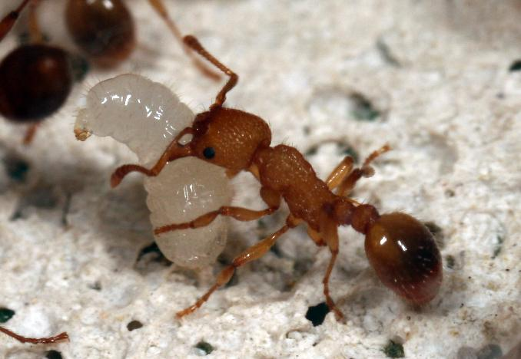
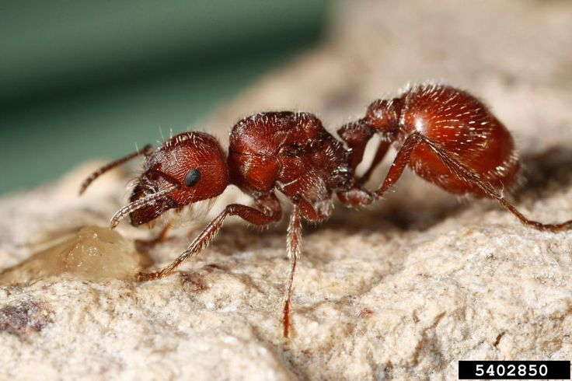
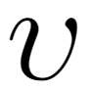
Ants’ decision making
The rate of interaction carries the message (Deborah Gordon, 2010).
=

Slide 4
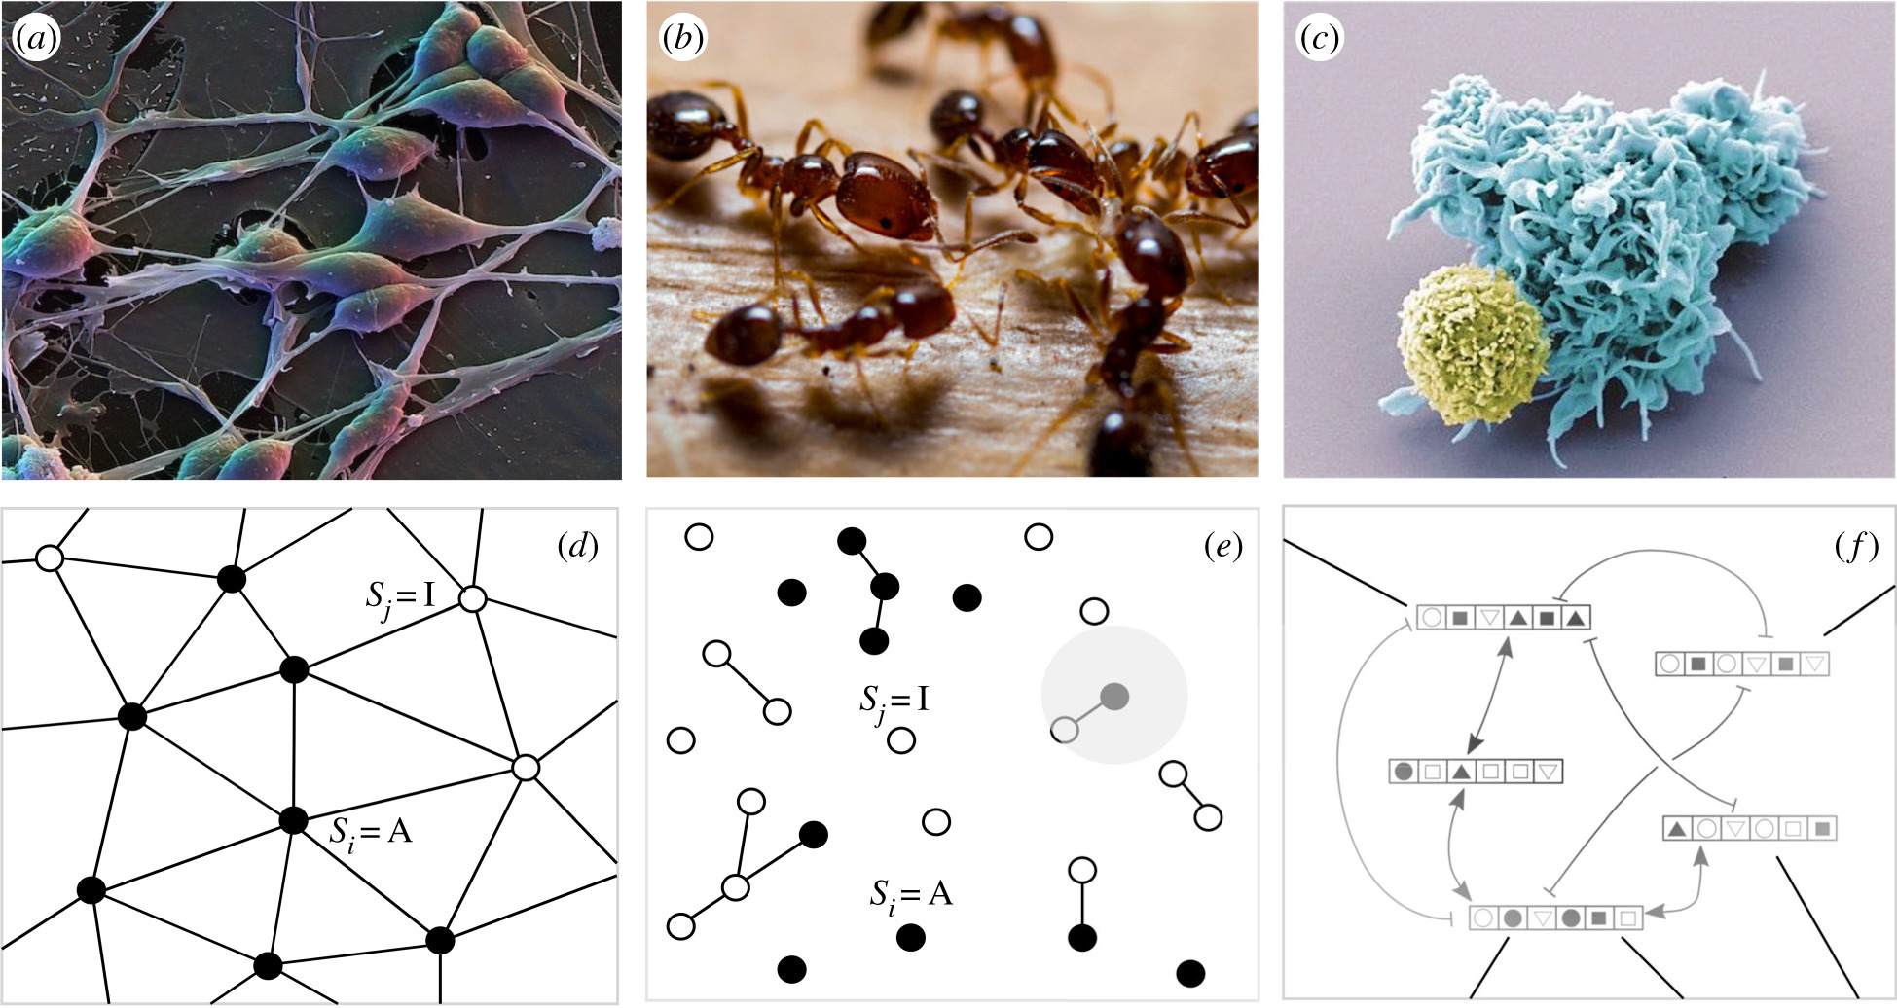
Ants as computational units
Neurons
Ants
Graph representing a ‘solid’ network
Graph representing a ‘fluid’ network, where connections are not fixed and occur locally in some radius (r, grey circle).
a)
b)
c)
d)
Modified from Piñero & Solé, 2019

Slide 5
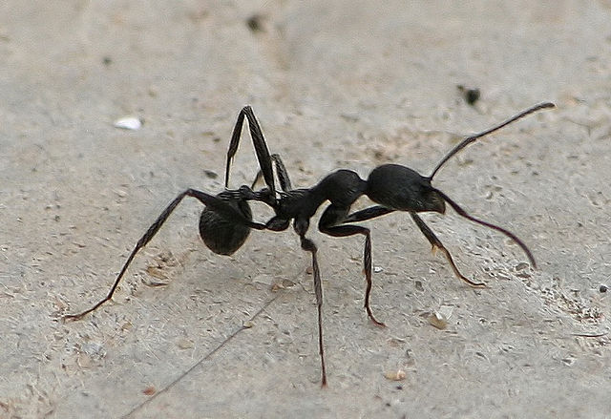
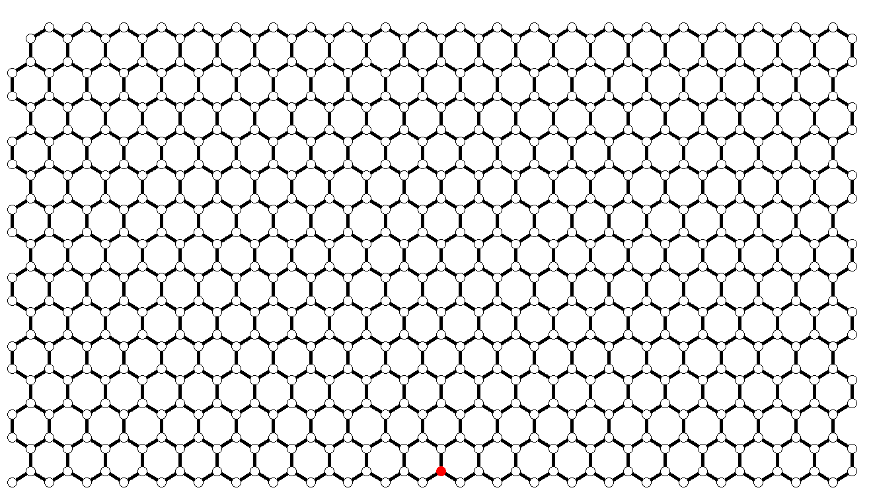
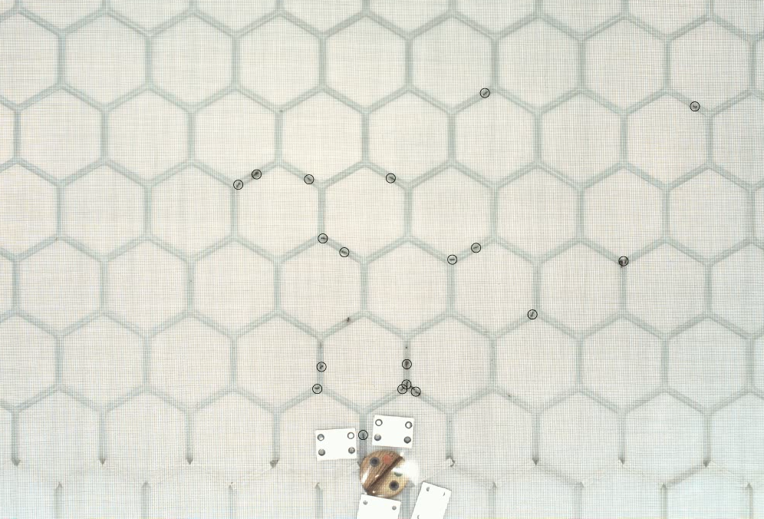
Experimental setup
Aphaenogaster senilis Ants forage in the arena for 3h
Subdominant species
Group recruitment (no pheromone trail)

Slide 6
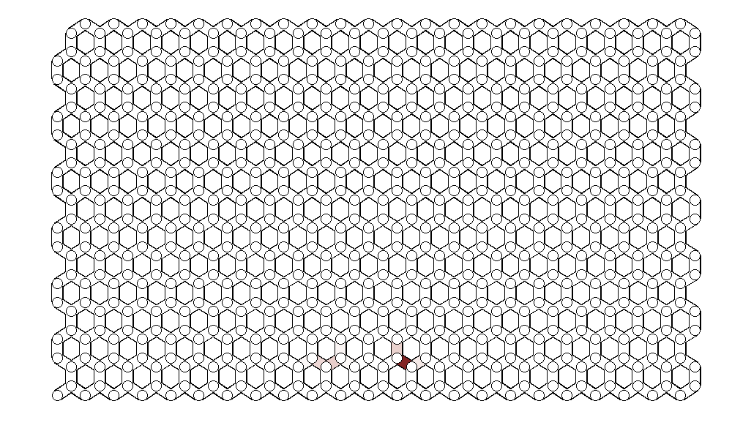
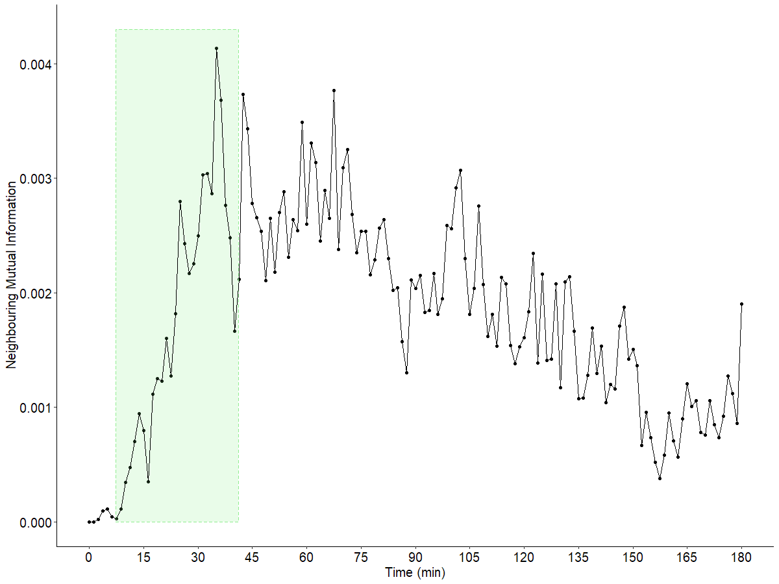
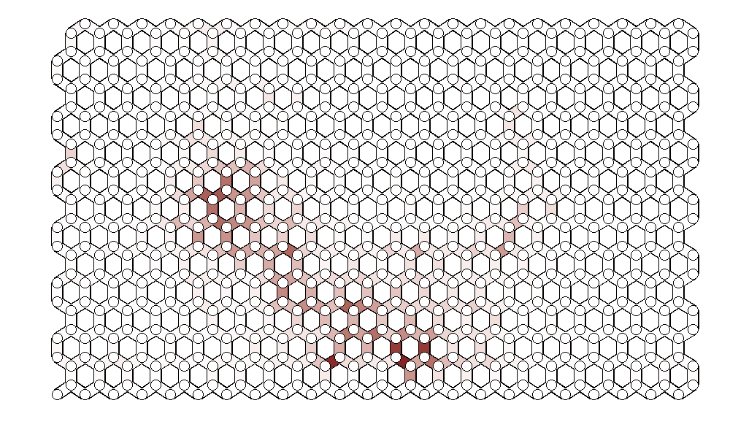
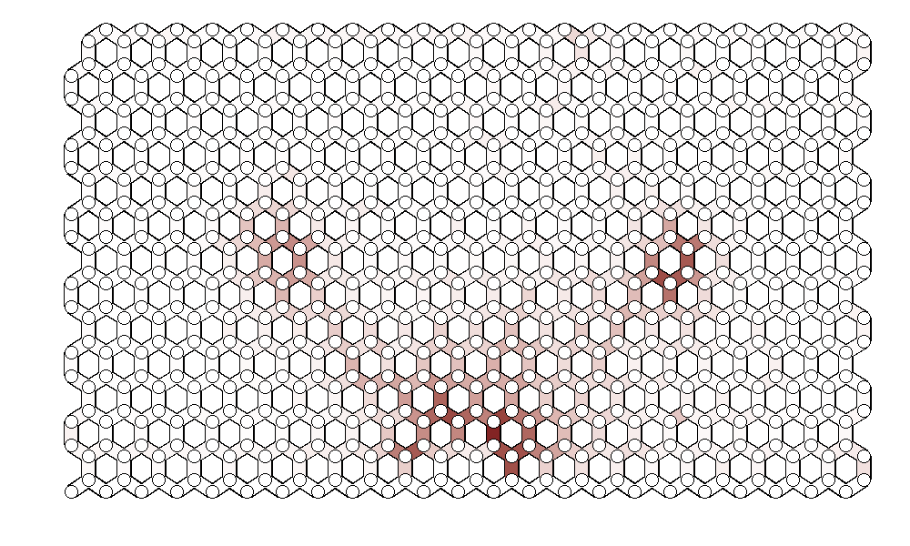
Mutual information
Phase 1*
(10 mins)
Phase 2**
(10 – 40’)
Phase 3*** (40 – 180’) * ** ***

Slide 7
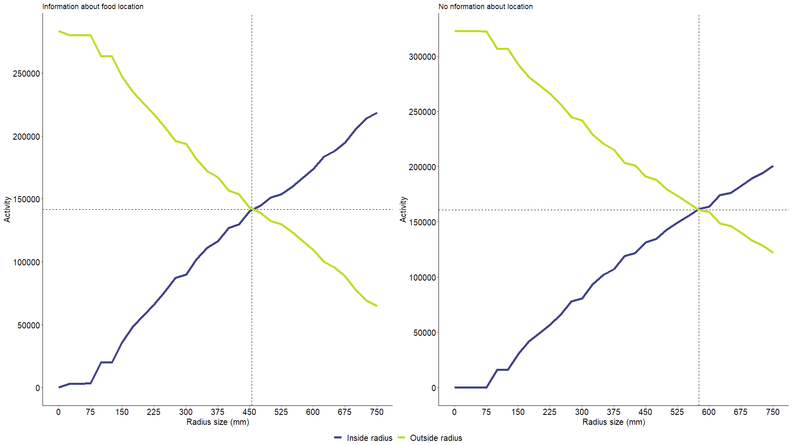
Nest influence (stationary)
With information Without information
Activity of ants considering an area of radius r Green: activity outside radius
Purple: activity inside radius

Slide 8
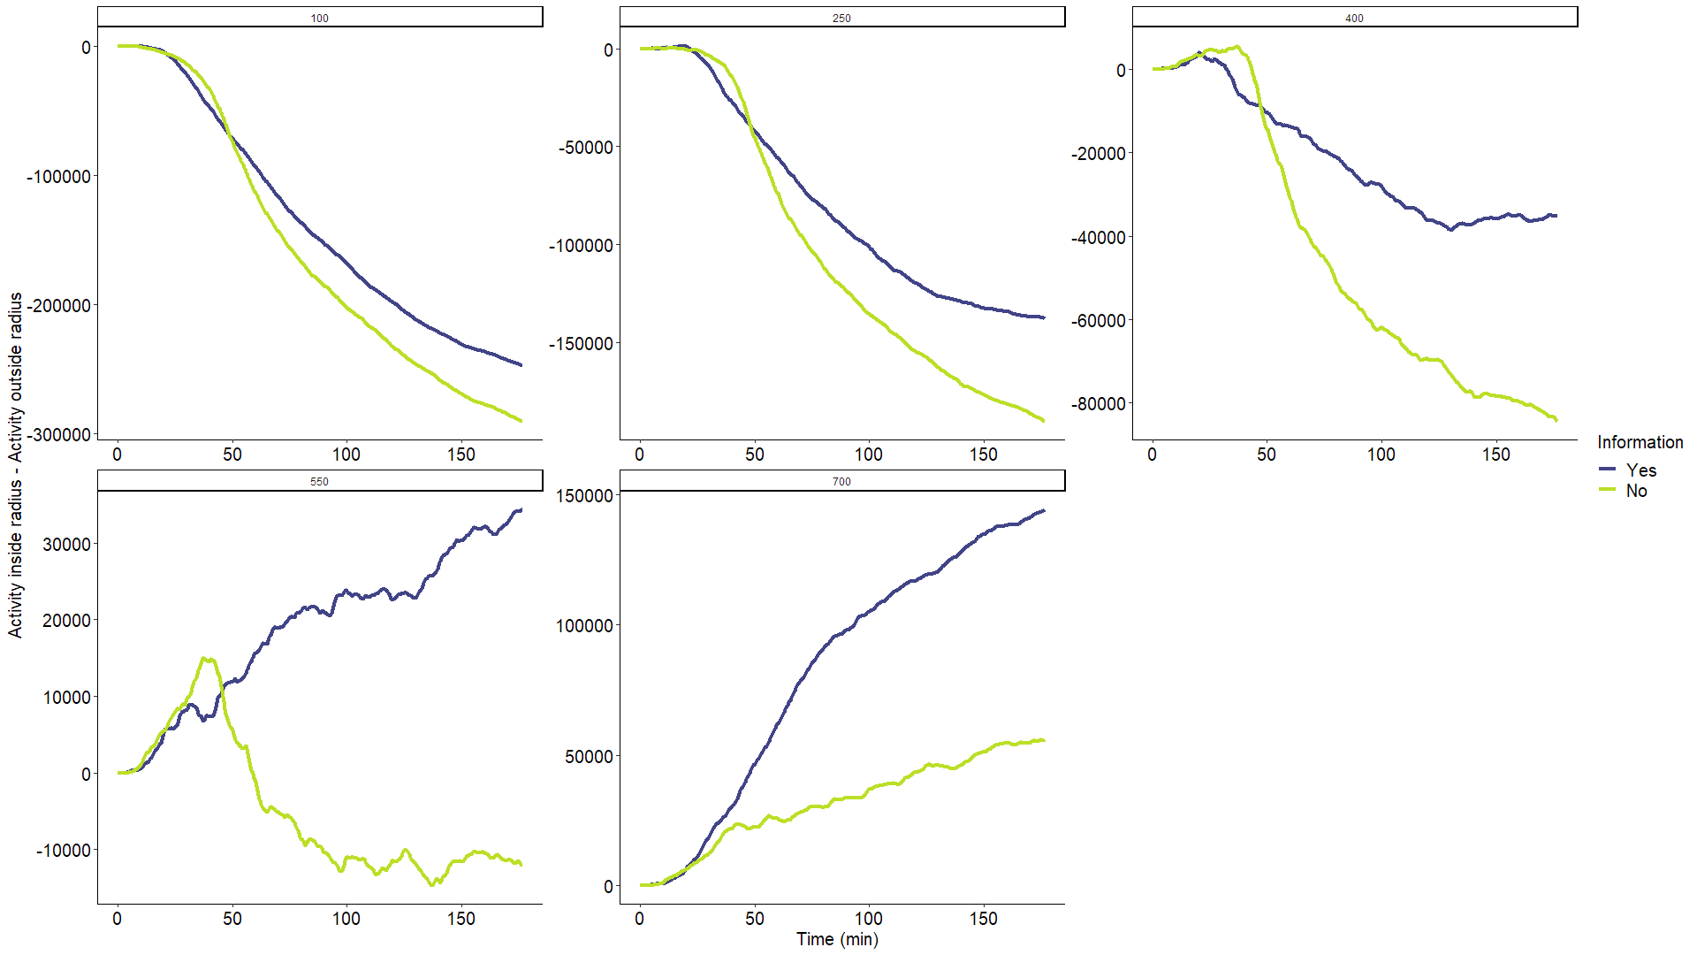
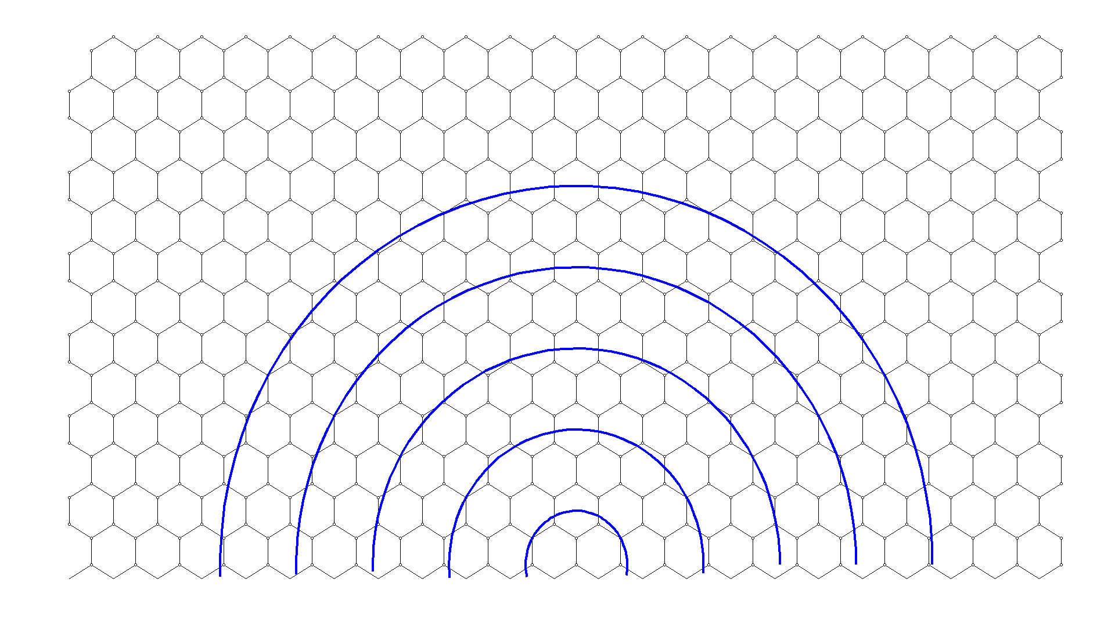
Dynamics of nest influence
Activity inside (A_{i}) radius in respect to activity outside (A_{o}) radius (A_{i}-A_{o}) Below the critical radius (r = 450 Info; r = 600 no info) there is more activity outside the boundary

Slide 9
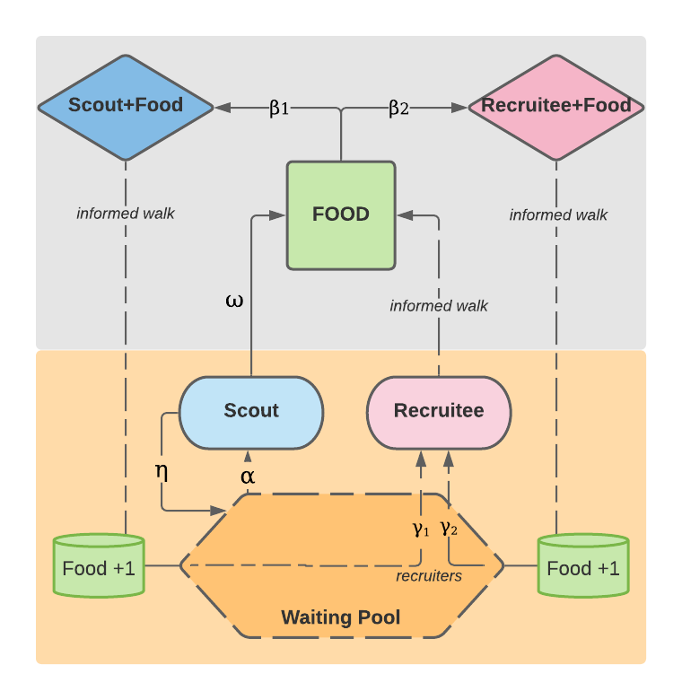
First approach for an Agent Based Model (ABM)
α = Scouts leaving nest β = Pick food and become recruiter γ = Recruit ω = Move η = Go back to nest (controls overflow of ants from nest to arena)

Slide 10
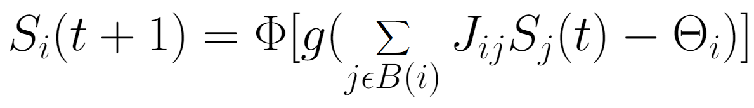
New approach for ABM
Model presented in Solé and Miramontes, 1993

Slide 11
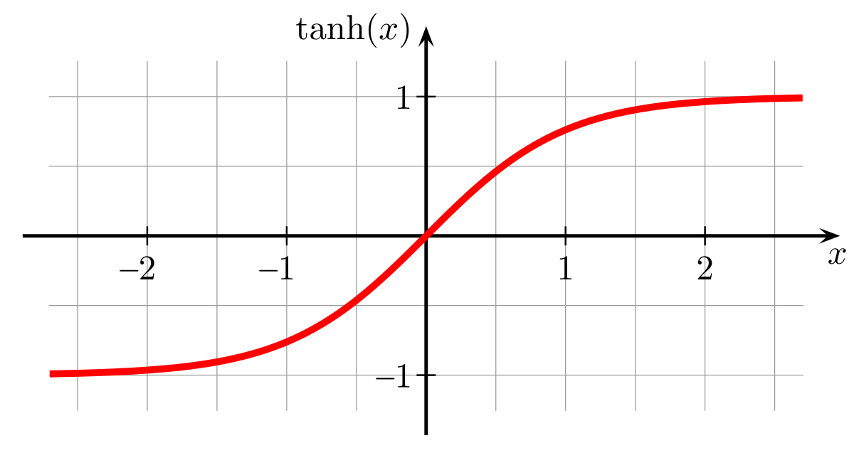
Parameter description: Sigmoid function
Phi = Threshold function; tanh (x)
x < 0 = y < 0
x > 0 = y > 0

Slide 12
Parameter description: Gain
g [0, 1] = a scalar affecting the slope of the function (more gradual the closer to one, steeper the closer to 0).

Slide 13
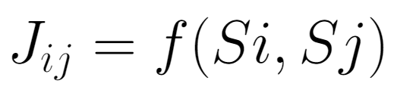
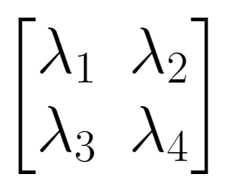
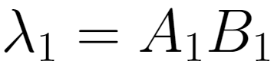
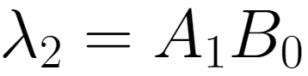
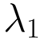
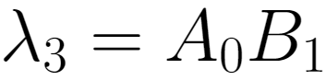
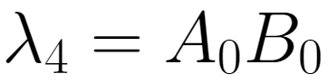
Parameter description: Coupling matrix
Strength of interaction as a function of the states of i and j.
A pair of interacting ants A_{active} – B_{active}
the coefficient of interaction would be

Slide 14
Parameter description: Agent state
S_{j}(t) = state of agent j at time t (typically takes values in range[-1, 1])

Slide 15
Parameter description: Threshold
= Threshold value (defines the activation threshold for the agent i)

Slide 16
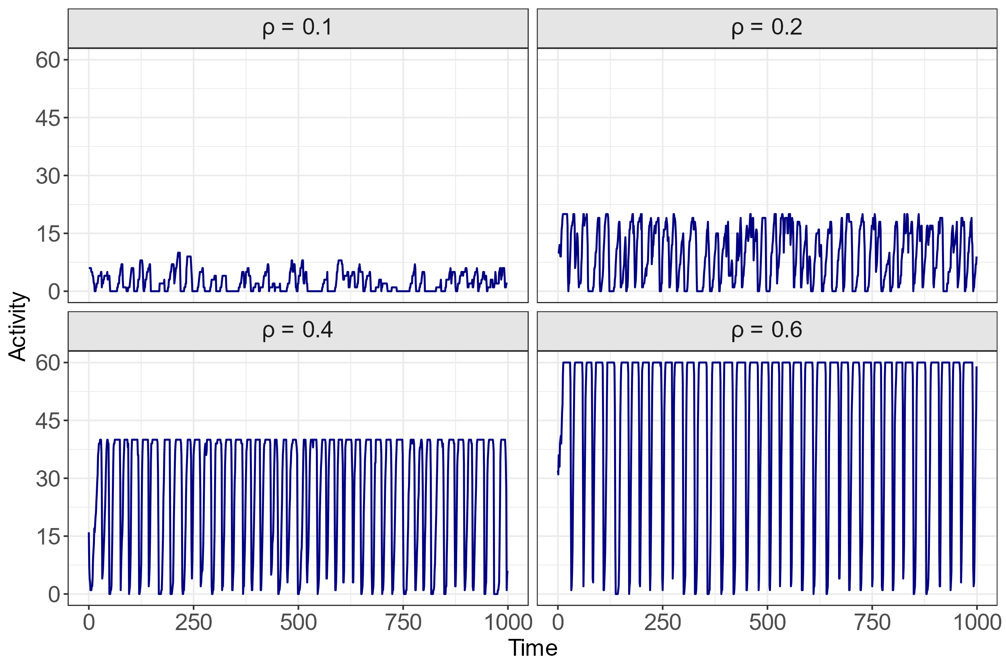
Preliminary results
Stationary view:
Fixed densities (unchanging number of ants).
At higher densities,
activity oscillatory patterns
become more ordered
(consistent period).

Slide 17
Work in progress & future perspectives
Model 1: focus on giving ‘some’ meaning to interactions.
Model 2: ants states are meaningful and can have ‘memory’ and information exchange among themselves and with the environment.

Slide 18
Conclusions
Ants exhibit complex foraging dynamics. These dynamics adapt to different contexts with varying degrees of uncertainty or information.
Experimental setups that mimic theoretic frameworks benefit from powerful analytical tools. This helps to gain insights about fundamental (biological) mechanisms.
Moreover, this ‘theory to experiments’ loop can be iterated, further improving theoretical models, and inspiring new experimental designs.

Slide 19
Information flow and behavioural plasticity guide the phases of foraging in Aphaenogaster senilis
¹Pol Fernández-López & ^{1,2,3}Frederic Bartumeus
¹Centre d’estudis avançats de Blanes (CEAB)
²Centre de Recerca Ecològica i Aplicacions Forestals (CREAF)
³Institucio Catalana de Recerca i Estudis Avançats (ICREA)

